Slide 1
POTFOLIOS & RESUMES

Slide 2
TOPICS TO BE MENTIONED
Personal Data
Job objective / Career Goal / About
Technical Skills + Languages + Personal skills
Work Experience + PORTFOLIO
Education & Qualifications / Awards
Miscellaneous / Hobbies / Interests
References
Contact box
PDF resume to be downloaded

Slide 3
Personal data: Name & Surname
Date of birth: 5 Feb 1989 / Feb.5, 1989
Address: ______________, France
Phone #: +33(0)________________
Email: (make sure it sounds professional!!!)
LinkedIn, driving license…
Photo ?
Activity 1:
Reformulate your Client’s needs (not the wants!).

Slide 4
JOB OBJECTIVE / ABOUT
A written paragraph expressing who you are (studies), your main strengths, what type of job you are looking for (e.g. the one of the ad) and why (no contraction, very formal).
On top of your resume
formulate your Client’s needs (not the wants!).

Slide 5
TECHNICAL SKILLS
Focus on your own computer skills / job-related skills:
Detail O.S., software, languages and activities
Mention Levels and scale: candy bars (or stars)
On top of your resume
(not the wants!).

Slide 6
LANGUAGES
Level: B1/B2; intermediate, upper intermediate, expert/fluent
(not the wants!).
PERSONAL SKILLS
What kind of worker are you ?
(not the wants!).
I manage my time well and can concentrate on multiple projects at once.
I am self-directed and able to take initiative.
I am trustworthy and appreciate the importance of responsibility.
I am self-assured and have excellent presentation ability. I enjoy speaking in public.
I am innovative, dynamic and confident.
I am orderly, methodical and have strong organizational skills.

Slide 7
WORK EXPERIENCE
Dates Company name (activity ; size) – Town, country: Missions: Design-ed/ing the company website with Wordpress and PHP
Dates Company name (activity ; size) – Town, country: Team project (Second-year university project) Designing the company website with...
Dates Personal Projects / Freelance
Description, technologies and links
=> Central position / in reverse chronological order
Do not write if not accurate (e.g: ‘working at a chemist’s for one week’ is not relevant and cannot be checked by the recruiter)

Slide 8
PORTFOLIO
Tiles for every project, even uncomplete ones if they can show the quality of your work/code/creativity
Technical description, code extracts, link (or screenshots)
(not the wants!).

Slide 9
EDUCATION & QUALIFICATIONS / AWARDS
in reverse chronological order / DO NOT TRANSLATE: always give the French name and then explain it.
Dates LP DIM (Professional Bachelor’s Degree in multi-platform software development) – Sandwich course
CCI Annecy / University of Savoy / IUT Annecy – Annecy-le-Vieux, France
Dates DUT Informatique (2-year university diploma in computer science)
USMB/ IUT Annecy – Annecy-le-Vieux, France
Dates French Baccalaureate SSI (High School diploma specialized in science and computer engineering) with (high) honors Baudelaire High school – Annecy, France
(not the wants!).

Slide 10
MISCELLANEOUS / HOBBIES / INTERESTS
Interests / hobbies but detailed (not just ‘soccer’: club? How long? Level?)
BAFA (diploma taken to be a children’s camp instructor).
(not the wants!).

Slide 11
REFERENCES
2 References: 2 people who can recommend you.
2 people: Name, position, company – town, country: email/phone number +33(0)______
=> Bottom of the resume
(not the wants!).

Slide 12
CONTACT BOX
+ button to download a PDF resume/CV
Mind international standards in terms of CV:
https://www.travailler-en-suisse.ch/emploi-suisse/dossier-candidature/cv-suisse/differences-cv-suisse-cv-francais
(not the wants!).

Slide 13
Examples
+ button to download a PDF resume/CV
Mind international standards in terms of CV:
https://www.travailler-en-suisse.ch/emploi-suisse/dossier-candidature/cv-suisse/differences-cv-suisse-cv-francais
(not the wants!).

Slide 14
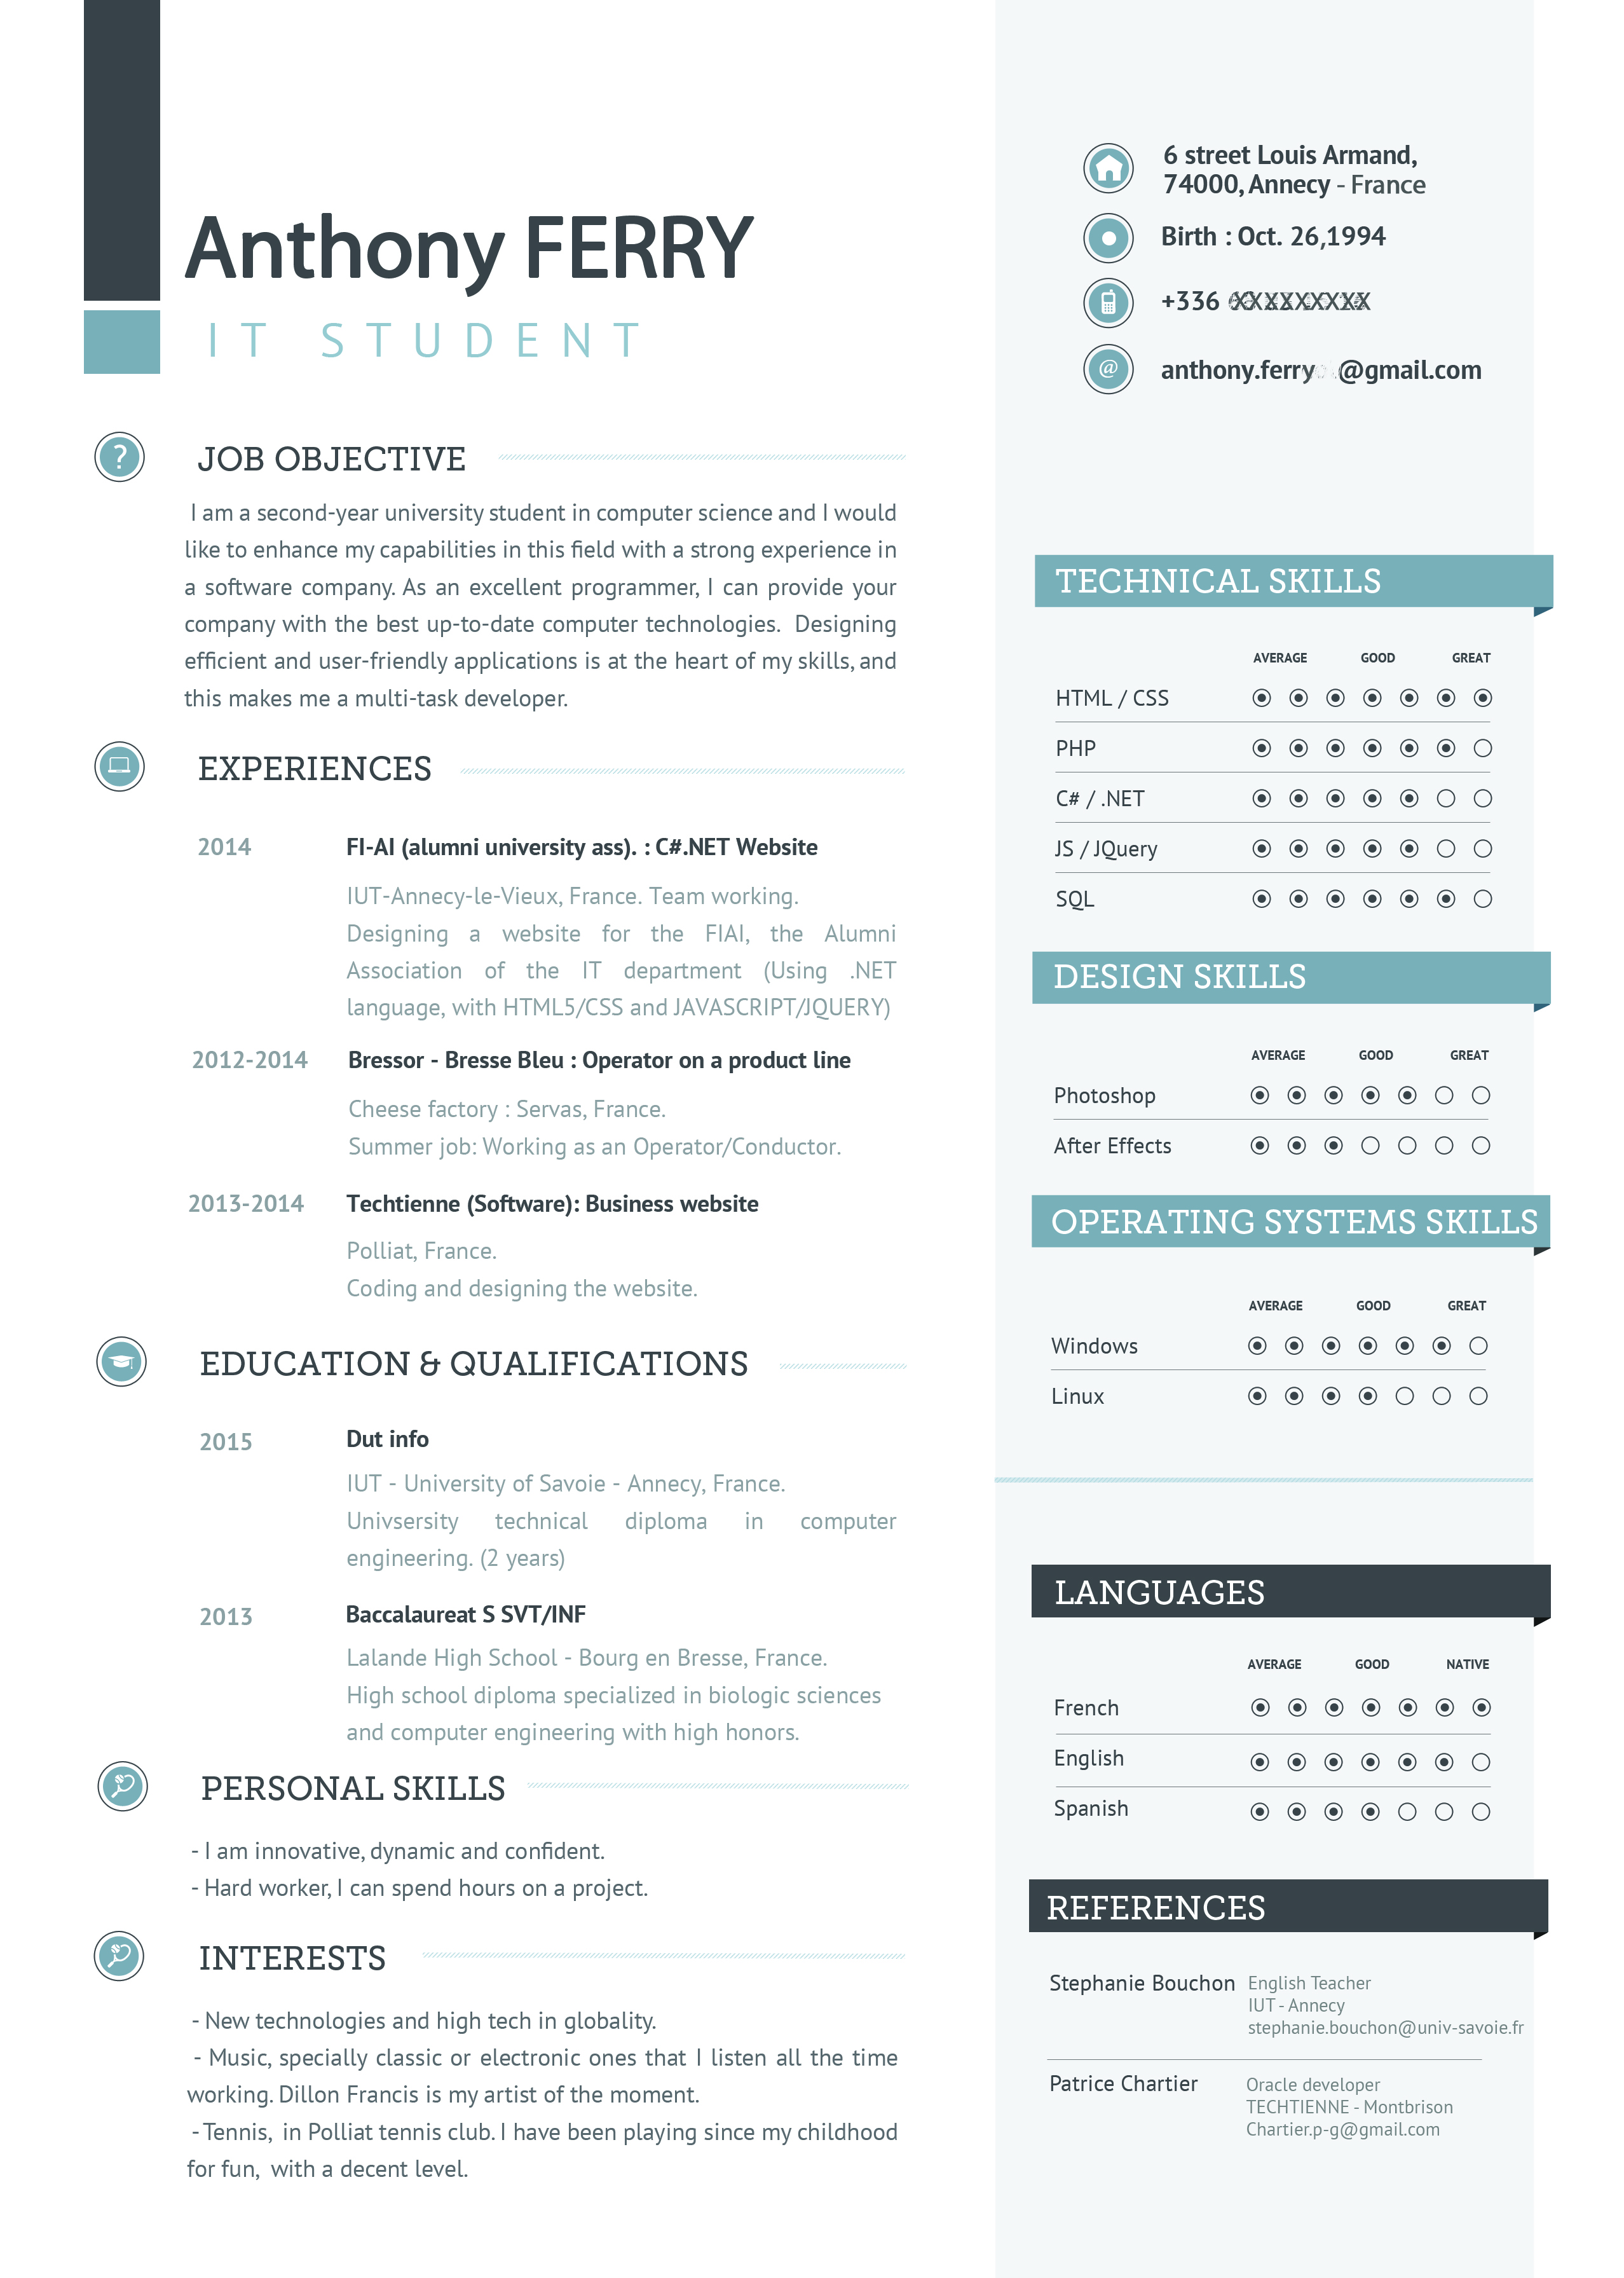
Examples

Slide 15
Examples
• http://www.premaz.com/
• http://elieldinaully.fr/
• http://jordan-geneve.fr/index.php

Slide 16
ASSESSMENT

Slide 17
DEADLINE: 13 MAI
STEPHANIE.BOUCHON@UNIV-SMB.FR

